Slide 1
SPEECH SIGNAL PROCESSING
PROJECT MID EVALUATION
03
Project : End of Phrase Detection.
06
04
05
TEAM: Srihari Bandarupalli, Jalluri Ram Gopal

Slide 2
USE CASE
Mainly our aim of our project is to predict end of clause. For that, basic approach can be to find the silenced part in the speech and that can be the end of clause. But differentiating whether it is comma or full stop is the challenge. For that, we need to use trends from pitch contour.
A pitch contour, in the context of linguistics and phonetics, refers to the pattern of changes in pitch or intonation in spoken language. Pitch is the perceptual quality of sound that allows us to distinguish between high and low tones in speech. In a pitch contour, the pitch of a person's voice rises and falls, creating patterns that contribute to the meaning and expression of speech. Ideally,
Rising pitch contour at the end of a sentence often indicates a question.
Falling pitch contours are typically used in declarative statements.
Sharp and noticeable rise in pitch, often used to emphasize a particular word or phrase within a sentence.

Slide 3
USE OF PITCH CONTOUR
Mainly our aim of our project is to predict end of clause. For that, basic approach can be to find the silenced part in the speech and that can be the end of clause. But differentiating whether it is comma or full stop is the challenge. For that, we need to use trends from pitch contour.
A pitch contour, in the context of linguistics and phonetics, refers to the pattern of changes in pitch or intonation in spoken language. Pitch is the perceptual quality of sound that allows us to distinguish between high and low tones in speech. In a pitch contour, the pitch of a person's voice rises and falls, creating patterns that contribute to the meaning and expression of speech. Ideally,
Rising pitch contour at the end of a sentence often indicates a question.
Falling pitch contours are typically used in declarative statements.
Sharp and noticeable rise in pitch, often used to emphasize a particular word or phrase within a sentence.

Slide 4
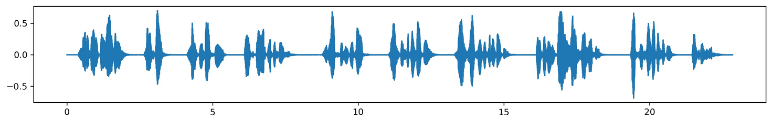
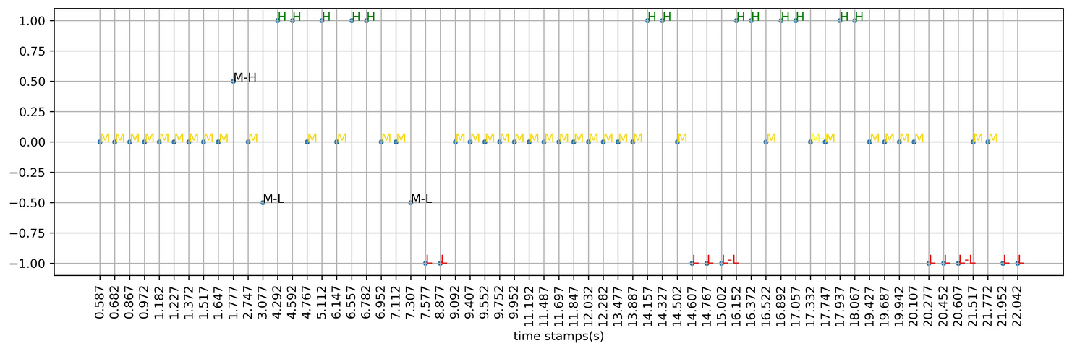
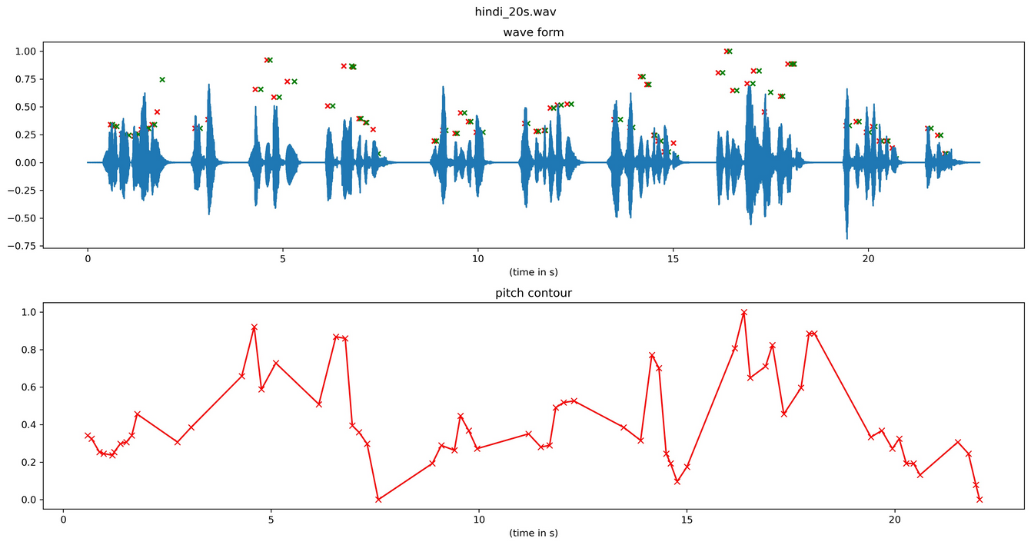
OBSERVING TREND
20SECONDS_HINDI.WAV
Waveform
Quantized pitch plot
Above plot involves the quantization of fundamental frequency f0(pitch) between levels L, M, H. If f0_start is not equal to f0_end, combination of two different quantization levels is considered.
L (-1)
M-L (-0.5)
M (0)
M-H (0.5)
H (1)
Pitch Counter

Slide 5
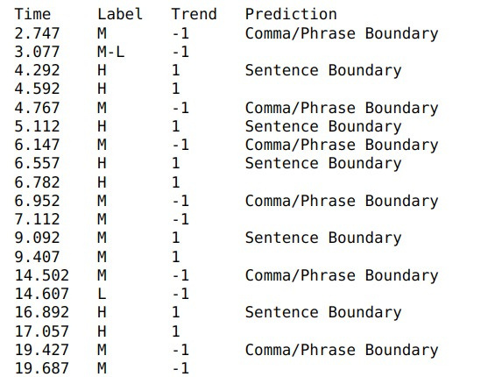
TREND
(for hindi audio)
We can observe that in the quantized pitch plot, full stop is observed when the contour is increasing and comma when the counter is decreasing (from the plot shown in slide 3).
Now using this trend lets check for a telugu audio signal.
L ->(+1) M ->(-1) _L : Comma
L ->(+1) H ->(-1) _M/L : Comma
M ->(+1) H ->(-1) _M/L : Comma
M ->(-1) L ->(+1) _M/H : Sentence Boundary
H ->(-1) M ->(+1) _H : Sentence Boundary
H ->(-1) L ->(+1) _M/H : Sentence Boundary

Slide 6
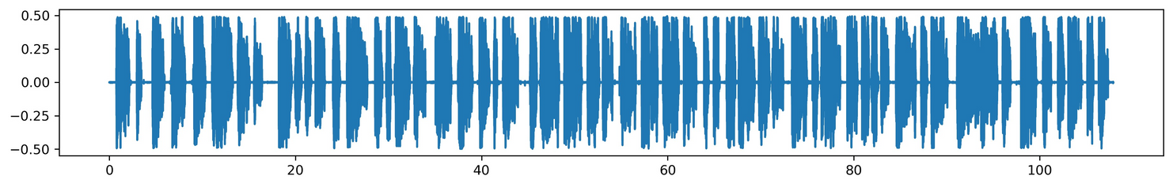
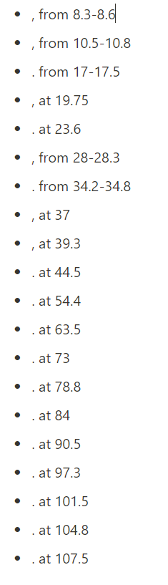
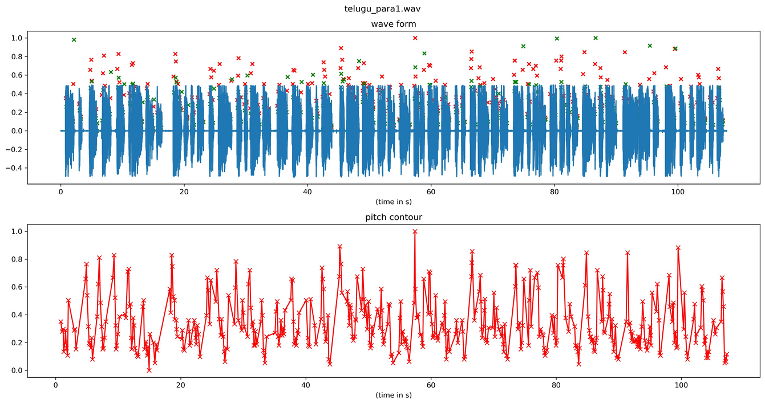
CHECKING THE TREND
telugu_para1.wav
location of pauses
(from txt file)
Waveform
Pitch Contour

Slide 7
FURTHER IMPROVEMENTS
Here in the telugu_para1.wav, we could observe many rises/falls which are greater than the number of commas and full-stops used. As we know that end of phrase or clause is associated with a silenced region and we know that silenced region has no pitch, we need to consider the trends(rise/fall) which are present near the silenced regions.
Until now, we used only the neutral speech files. We will be looking on how this trend gets varied if emotional speeches involved.

